Slide 1
Introduction (lec1-2)
Chitkara University Institute of Engineering and Technology,
Chitkara University, Punjab

Slide 2
Content
Introduction to Operating systems
Operating System role
Computer system architecture
Single processor
Multiprocessor Systems
Clustered Systems
OS structure
OS operations
Components of OS
Process management
Memory management
Storage management
I/O management

Slide 3
Introduction to Operating systems
An operating system acts as an intermediary between the user of a computer and computer hardware. The purpose of an operating system is to provide an environment in which a user can execute programs conveniently and efficiently.
An operating system is software that manages computer hardware. The hardware must provide appropriate mechanisms to ensure the correct operation of the computer system and to prevent user programs from interfering with the proper operation of the system. A more common definition is that the operating system is the one program running at all times on the computer (usually called the kernel), with all else being application programs.
An operating system is concerned with the allocation of resources and services, such as memory, processors, devices, and information. The operating system correspondingly includes programs to manage these resources, such as a traffic controller, a scheduler, a memory management module, I/O programs, and a file system.

Slide 4
Operating System role
Resource Management: The operating system (OS) manages hardware resources such as CPU, memory, disk storage, and input/output devices, ensuring their efficient utilization during model training and testing.
Task Scheduling: The OS schedules tasks, prioritizes processes, and allocates CPU time, ensuring smooth execution of computationally intensive processes like training machine learning models.
Memory Management: It handles memory allocation for storing datasets, models, and intermediate computations, optimizing system performance and avoiding memory overflow.
Parallel Processing Support: Operating systems enable parallel execution through threading and multiprocessing, which is crucial for models that rely on GPUs or multi-core processors.

Slide 5
Cont……..
Driver Support: Provides necessary drivers to interface with hardware components such as GPUs, ensuring compatibility and leveraging hardware acceleration for faster computation.
File System Management: Facilitates efficient data storage, retrieval, and management of large datasets.
Error Handling: Detects and manages system errors, ensuring the reliability and stability of processes during long training sessions or simulations.
Security: Offers secure environments to protect sensitive datasets and ensures safe execution of applications, preventing unauthorized access.
Networking: Provides support for data transfer and communication in distributed computing environments or cloud-based machine learning workflows.
User Interface and Automation: Allows seamless user interaction through graphical interfaces or command-line tools, enabling efficient model execution and result analysis.

Slide 6
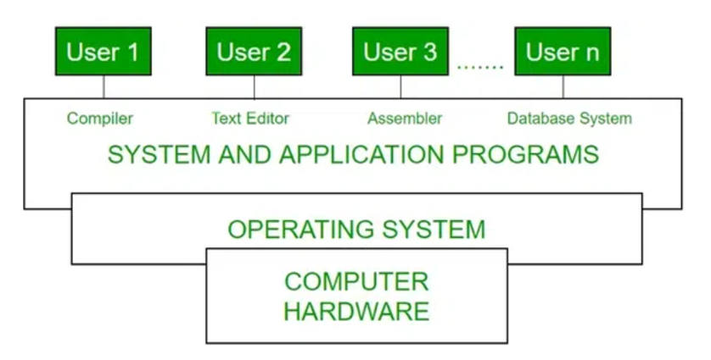
Computer system architecture
The process operating system as User Interface:
User
System and application programs
Operating system
Hardware
Figure 1. Conceptual View of Computer System
Notes:
System software provides a platform for other software to run. System Software maintains the system resources and gives the path for application software to run. while application software performs specific tasks for the user

Slide 7
Cont…….
Every general-purpose computer consists of hardware, an operating system(s), system programs, and application programs. The hardware consists of memory, CPU, ALU, I/O devices, peripheral devices, and storage devices. The system program consists of compilers, loaders, editors, OS, etc. The application program consists of business programs and database programs.
Every computer must have an operating system to run other programs. The operating system coordinates the use of the hardware among the various system programs and application programs for various users. It simply provides an environment within which other programs can do useful work.
The operating system is a set of special programs that run on a computer system that allows it to work properly. It performs basic tasks such as recognizing input from the keyboard, keeping track of files and directories on the disk, sending output to the display screen, and controlling peripheral devices.

Slide 8
Single Processor System
A single processor system refers to a computer system that contains only one central processing unit (CPU) responsible for executing all tasks. It performs operations such as arithmetic, logic, control, and input/output (I/O) management in a sequential manner.
Key Characteristics:
Sequential Task Execution: Only one task or instruction is executed at any given moment.
Resource Management: A single CPU manages all resources, including memory, storage, and I/O devices.
Simplicity: Design and implementation are straightforward compared to multi-processor systems.
Performance: Suitable for tasks that don't require high computational power or parallel processing.

Slide 9
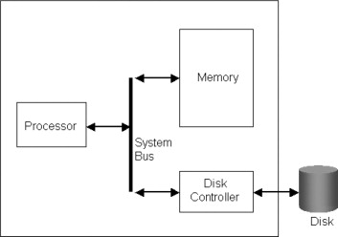
Figure 2: Single-Processor operating system
The diagram typically includes:
Disk Controller: The disk controller is a hardware component that manages the communication between the CPU and storage devices (e.g., hard drives or SSDs).
Memory (RAM): Temporary storage for running applications and active processes.
Input/Output Devices: Devices like keyboards, monitors, and storage drives connected to the system.
Bus: Communication channel connecting the CPU, memory, and I/O devices.

Slide 10
Advantages of Single Processor Systems
Simplicity: Single processor systems are easier to design, implement, and maintain due to their straightforward architecture.
Cost-Effective: They are typically less expensive than multi-processor systems, making them ideal for personal and small-scale applications.
Power Efficiency: These systems consume less power compared to multi-processor systems, suitable for energy-constrained environments.
Ease of Debugging: Debugging and troubleshooting are simpler because of the centralized control and absence of inter-processor communication.
Low Latency: Single processor systems can process tasks without the overhead of managing communication between multiple processors.

Slide 11
Disadvantages of Single Processor Systems
Limited Performance: Single processors have limited computational capacity, making them unsuitable for high-performance or parallel-processing tasks.
Scalability Issues: They cannot handle increased workloads effectively compared to multi-processor or distributed systems.
Resource Contention: With one CPU, all tasks must share the same resources, leading to potential bottlenecks.
Single Point of Failure: If the processor fails, the entire system becomes inoperable, unlike multi-processor systems with redundancy.
Inability to Handle Concurrent Tasks: Multitasking relies on time-sharing rather than true parallelism, which can result in slower processing of simultaneous tasks.

Slide 12
Applications
Single processor systems are commonly used in personal computers, small-scale servers, and embedded systems where performance demands are moderate, and cost-effectiveness is a priority.

Slide 13
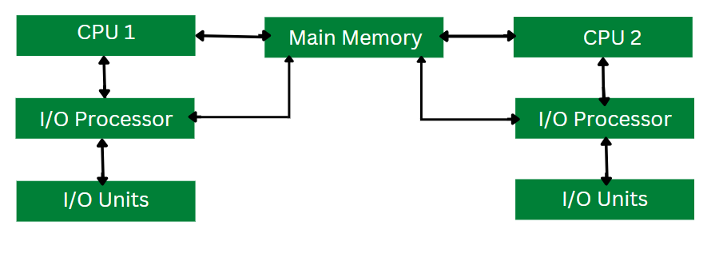
Multiprocessor Systems
A multiprocessor operating system supports a system with multiple CPUs working together to perform tasks. These systems are designed to manage and coordinate the CPUs efficiently, ensuring optimized use of resources, improved performance, and fault tolerance.
Figure 3: Working of Multiprocessing Operating System

Slide 14
Working of Multi-Processing System
Multi-processing operating system consists of multiple CPUs. Each CPU is connected to the main memory.
The task to be performed id divided among all the processors.
For faster execution and improved performance, each processor is assigned a specific task.
Once all the tasks of each processor are completed they are compiled together in order to produce a single output.
The allocation of resources for each processor is handled by the operating system. This process results in better utilization of the available resources and improved performance.

Slide 15
Key Features of Multiprocessor OS Systems
Symmetric Multiprocessing (SMP): All processors share the same memory and are treated equally by the OS.
Asymmetric Multiprocessing (AMP): Processors are assigned specific tasks, with one acting as a master to control the others.
Concurrency: Ability to execute multiple processes simultaneously by distributing workloads across processors.
Shared Memory Access: Processors access a common memory space, enabling communication and synchronization.
Load Balancing: The OS distributes tasks evenly among processors to avoid overloading any single CPU.

Slide 16
Advantages of Multiprocessor OS Systems
Improved Performance: Tasks are divided among processors, reducing execution time and enhancing throughput.
Fault Tolerance: If one processor fails, the system can continue functioning with the remaining processors.
Scalability: Additional processors can be added to improve performance as the workload grows.
True Parallel Processing: Enables simultaneous execution of multiple tasks, suitable for compute-intensive applications.
Resource Sharing: Shared memory allows efficient resource utilization and inter-process communication.

Slide 17
Disadvantages of Multiprocessor OS Systems
Complexity: Designing and managing multiprocessor systems is more challenging than single-processor systems.
Cost: Multiprocessor systems are expensive due to additional hardware and software complexity.
Synchronization Issues: Shared memory and resource access can lead to contention and require complex synchronization mechanisms.
Overhead: Communication between processors can add overhead, reducing efficiency in some scenarios.
Dependency on Software: Performance gains depend on the software being optimized for parallel execution.

Slide 18
Applications of Multiprocessor OS Systems
High-Performance Computing (HPC): Used in supercomputers for scientific research, simulations, and complex computations.
Data Centers: Multiprocessor systems power servers handling large-scale web services, databases, and cloud computing.
Gaming Consoles: Modern gaming consoles use multiprocessor systems for rendering high-quality graphics and gameplay.
AI and Machine Learning: Used to accelerate training and inference tasks in deep learning models.
Real-Time Systems: Found in automotive and industrial control systems requiring high reliability and quick responses.

Slide 19
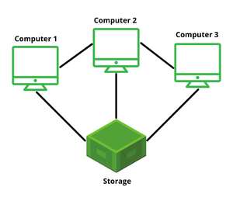
Clustered Systems
Clustered operating systems are designed to manage and coordinate multiple computers (or nodes) working together as a unified system. These systems use clusters of interconnected machines to achieve high availability, scalability, and performance.
Figure 4: Clustered Operating System

Slide 20
Key Features of Clustered OS
Node-Based Architecture: Multiple computers, or nodes, are connected to form a cluster. Each node runs its own OS but is coordinated to act as a single unit.
High Availability: If one node fails, others in the cluster take over, ensuring uninterrupted service.
Scalability: Nodes can be added or removed as needed, making it easier to handle growing workloads.
Load Balancing: Tasks are distributed across nodes to prevent any single node from being overwhelmed.
Redundancy: Data and processes are replicated across nodes to prevent data loss and enable fault tolerance.
Interconnect Network: Nodes communicate through high-speed networks such as Ethernet or InfiniBand.

Slide 21
Types of Clustered OS
High-Performance Clusters (HPC): Designed for computationally intensive tasks, such as simulations and scientific research.
High-Availability Clusters (HA): Focused on ensuring uptime and reliability, often used for critical applications like databases.
Load-Balancing Clusters: Distribute workloads among nodes for improved performance, common in web services.

Slide 22
Advantages of Clustered OS
Fault Tolerance: Redundant nodes ensure continuous service even in case of hardware or software failure.
Scalability: Nodes can be easily added to accommodate increased workloads.
Improved Performance: Tasks are divided among multiple nodes, enhancing processing power and speed.
Cost-Effective: Using commodity hardware reduces costs compared to building supercomputers.
Flexibility: Nodes can be configured and reconfigured based on the application’s requirements.

Slide 23
Disadvantages of Clustered OS
Complex Management: Managing and configuring clusters can be challenging, especially as the number of nodes increases.
Cost of Setup: Requires high-speed networks and specialized software, which can be expensive.
Synchronization Overhead: Ensuring consistency across nodes can introduce latency.
Dependency on Interconnects: Performance heavily depends on the speed and reliability of the interconnect network.

Slide 24
Applications of Clustered OS
Data Centers: Used for hosting cloud services and handling large-scale data processing.
Scientific Research: Perform complex computations and simulations in areas like weather prediction and molecular modeling.
Web Servers: Enable load balancing and high availability for e-commerce and web hosting.
Big Data Analytics: Handle distributed processing of massive datasets, such as in Hadoop or Apache Spark clusters.
Enterprise Systems: Support critical business applications requiring high reliability and scalability.

Slide 25
Operating Systems Structure (multitask and multi program)
Multiprogramming (Batch system) needed for efficiency
Single user cannot keep CPU and I/O devices busy at all times
Multiprogramming organizes jobs (code and data) so CPU always has one to execute
A subset of total jobs in system is kept in memory
One job selected and run via job scheduling
When it has to wait (for I/O for example), OS switches to another job
Timesharing (multitasking) is logical extension in which CPU switches jobs so frequently that users can interact with each job while it is running, creating interactive computing
Response time should be < 1 second
Each user has at least one program executing in memory 🢡process
If several jobs ready to run at the same time 🢡 CPU scheduling
If processes don’t fit in memory, swapping moves them in and out to run
Virtual memory allows execution of processes not completely in memory

Slide 26
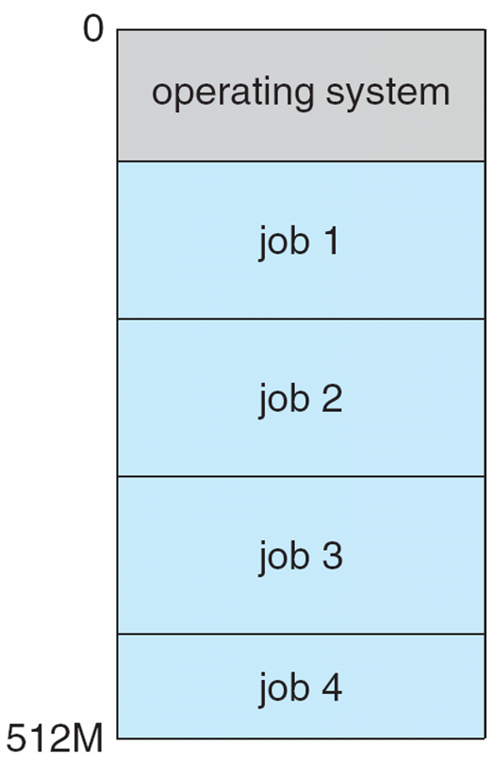
Memory Layout for Multiprogrammed System

Slide 27
Operating-System Operations
Modern OS are Interrupt driven (hardware and software)
Hardware interrupt by one of the devices
Software interrupt (exception or trap):
Software error (e.g., division by zero)
Request for operating system service
Other process problems include infinite loop, processes modifying each other or the operating system

Slide 28
Operating-System Operations (cont.)
Dual-mode operation allows OS to protect itself and other system components
User mode and kernel mode (also called supervisor mode, system mode, or privileged mode).
Mode bit provided by hardware
Provides ability to distinguish when system is running user code or kernel code
Some instructions designated as privileged, only executable in kernel mode
System call changes mode to kernel, return from call resets it to user
Increasingly CPUs support multi-mode operations
i.e. virtual machine manager (VMM) mode for guest VMs

Slide 29
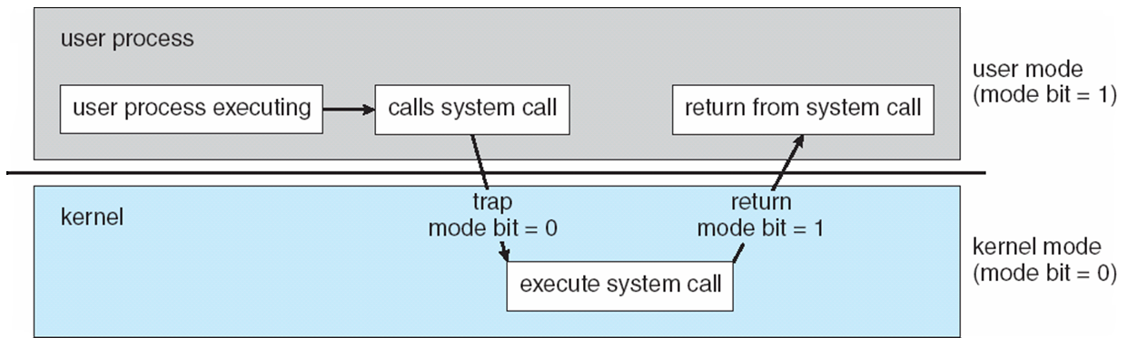
Transition from User to Kernel Mode
Timer to prevent infinite loop / process hogging resources
Timer is set to interrupt the computer after some time period
Keep a counter that is decremented by the physical clock.
Operating system set the counter (privileged instruction)
When counter zero generate an interrupt
Set up before scheduling process to regain control or terminate program that exceeds allotted time

Slide 30
Cont….
There are essential components of an operating system (OS). Here's a breakdown of each component:
Process Management:
This component manages processes (programs in execution), including their creation, scheduling, and termination.
It ensures that processes have enough CPU time to run and that processes do not interfere with each other. It also handles multitasking and context switching.
Key elements: Process scheduling, inter-process communication, process synchronization, and deadlock management.

Slide 31
Cont….
Memory Management:
Memory management is responsible for managing the system's memory (RAM) to ensure efficient use.
It allocates and deallocates memory to processes, ensures that each process has enough memory to run, and prevents processes from accessing each other's memory (providing isolation).
Key elements: Virtual memory, paging, segmentation, memory allocation, and garbage collection.
Storage Management:
This component is in charge of managing data storage, including both primary storage (RAM) and secondary storage (e.g., hard drives, SSDs).
It ensures that data is stored efficiently and can be retrieved quickly and reliably when needed.
Key elements: File systems, disk scheduling, disk management, and data backups.

Slide 32
Cont….
I/O Management:
I/O management controls the input and output operations between the computer system and external devices like keyboards, mice, printers, displays, and storage devices.
It provides a mechanism for reading data from and writing data to I/O devices, handling data transfer between the system and peripherals.
Key elements: Device drivers, buffers, queues, and I/O scheduling.
These components work together to ensure that the operating system functions smoothly, providing an interface for users and managing the underlying hardware efficiently.

Slide 33
OS operations
An operating system (OS) is a system software that manages hardware, software resources, and provides services for computer programs. Its operations can be broadly categorized as follows:
1. Process Management
Objective: Manage processes (programs in execution), including their creation, scheduling, and termination.
Operations:
Process creation and termination.
CPU scheduling for efficient process execution.
Synchronization and communication between processes.
Example: Allocating CPU time to multiple running applications, such as a browser and a video player.

Slide 34
Cont…..
2. Memory Management
Objective: Efficiently manage the computer's memory (RAM) for optimal performance.
Operations:
Allocation and deallocation of memory space for programs.
Paging and segmentation for memory organization.
Managing virtual memory to extend RAM using disk space.
Example: Keeping multiple tabs open in a web browser without crashing the system.
.

Slide 35
Cont…..
3. File System Management
Objective: Manage storage, organization, and retrieval of data in files and directories.
Operations:
File creation, deletion, and modification.
Managing access permissions for security.
File organization in directories for easy navigation.
Example: Storing a Word document in a specific folder

Slide 36
Cont……
4. Device Management
Objective: Coordinate the use of input/output devices like keyboards, printers, and storage drives.
Operations:
Managing device drivers for hardware interaction.
Buffering and spooling for efficient data handling.
Handling device communication via interrupt service routines (ISRs).
Example: Printing a document while continuing to work on other tasks.

Slide 37
Cont……
5. User Interface Management
Objective: Provide a user interface (UI) to interact with the system.
Operations:
Graphical User Interface (GUI) or Command-Line Interface (CLI).
Managing user sessions and input/output operations.
Example: Using the Windows Start menu or Linux Terminal to launch applications.

Slide 38
Cont……
6. Security and Access Control
Objective: Protect the system and data from unauthorized access or threats.
Operations:
User authentication through passwords or biometrics.
Access permissions for files and system resources.
Protection against malware or unauthorized software.
Example: Restricting file access to specific users

Slide 39
Cont……
7. Networking
Objective: Enable communication between computers in a network.
Operations:
Managing network protocols like TCP/IP.
Resource sharing, such as printers or files, over a network.
Handling data transmission and reception efficiently.
Example: Accessing a shared printer or transferring files via FTP.

Slide 40
Cont……
8. System Performance Monitoring
Objective: Monitor and optimize system performance.
Operations:
Tracking CPU and memory usage.
Managing system logs and diagnostics.
Providing tools for troubleshooting and tuning.
Example: Task Manager in Windows showing running processes and their resource usage.

Slide 41
Cont……
9. Multi-User and Multitasking Management
Objective: Support multiple users and multitasking efficiently.
Operations:
Allocating resources fairly among users.
Enabling multiple applications to run simultaneously.
Example: Running video editing software while browsing the web on a multi-user system.

Slide 42
Cont……
10. System Call Handling
Objective: Provide an interface for programs to request OS services.
Operations:
Handling system calls like file operations, memory allocation, and process control.
Example: A program saving a file invokes a system call to access the file system.
These operations collectively ensure that the OS serves as a bridge between hardware and users, enabling seamless interaction and efficient resource management.

Slide 43
Practice Questions
Q1.Why does a single-processor system require less complex synchronization mechanisms compared to a multiprocessor system?
No need for scheduling
No concurrent execution of instructions
Lower memory usage
Fewer I/O devices
Answer: B (Only one instruction executes at a time, avoiding race conditions.)
Q2.Which property MOST distinguishes a clustered system from a multiprocessor system?
A. Shared memory access B. High availability through redundancy C. Use of interrupts D. CPU scheduling algorithms
Answer: B(Clustered systems emphasize fault tolerance and availability via multiple nodes.)
Q3. Which OS structure BEST supports rapid evolution of services while minimizing kernel modifications?
A. Monolithic B. Layered C. Microkernel D. Simple structure
Answer: C (Microkernels move services to user space, enabling flexibility.)

Slide 44
Q4. An operating system switches from user mode to kernel mode when:
A process finishes execution
A system call is invoked
CPU cache misses occur
A context switch completes
Answer: B (System calls require privileged instructions.)
Q5. Why do monolithic kernels often outperform microkernels?
A. Fewer system calls B. Reduced context switches C. Better scheduling algorithms D. Less memory usage
Answer: B (Microkernels involve more user–kernel transitions.)
Q6. Which system is MOST suitable for high-performance scientific computations?
A. Single processor B. Clustered system C. Time-sharing system D. Embedded system
Answer: B (Clusters offer scalability and parallelism.)

